Slide 1
Strategic Leadership
607MAN 303MAN
Leadership & Strategic Change
Week 2

Slide 2



What we’re going to cover today…
Strategic leadership roles and styles
(2) Types and context of strategic change
(3) Levers for strategic change

Slide 3
Session Learning Outcomes
Evaluate and apply conceptual and practical approaches to strategic leadership in a range of different organisational settings.
Analyse contemporary research on the role of leadership in managing change.
Critically assess the relevance of leadership styles to key sector changes including globalisation, internationalisation, strategy, technological innovation and organisation development.
Identify and critically reflect on leadership capabilities, styles and strategies of key Business leaders across a range of sectors.
Evaluate an incident of strategic organisational change by exploring the role of leadership and the measurement and management of Key Performance Indicators (KPI’s).
Critically explore the ethical relationships between leaders and followers in relation to decision making, corporate governance and policy practices in organisations.

Slide 4

Leadership styles and roles

Slide 5
Theoretical base of Leadership
Theory X and Theory Y (McGregor 1960)
Theory X and Theory Y describe two views of people at work and may be used to describe two opposing management styles.
Theory X: the traditional view of direction and control
Theory X is based on the assumptions that:
The average human being has an inherent dislike of work and will avoid it if possible.
Because of this human dislike of work, most people must be coerced, controlled, directed, and threatened with punishment to get them to put forth adequate effort toward the achievement of organisational objectives.
The average human being prefers to be directed, wishes to avoid responsibility, has relatively little ambition, and wants security above all

Slide 6
Theoretical base of Leadership Theory X and Theory Y
Theory Y is based on the assumptions that:
Use of physical and mental effort in work is as natural as play or rest. The average human being does not inherently dislike work. Depending upon controllable conditions, work may be a source of satisfaction, or a source of punishment.
External control and the threat of punishment are not the only means for bringing about effort toward organisational objectives. People will exercise self-direction and self-control in the service of objectives to which they are committed.
Commitment to objectives is a function of the rewards associated with their achievement. The most significant of such rewards, e.g. the satisfaction of ego and self-actualisation needs, can be direct products of effort directed towards organisational objectives.
The average human being learns, under proper conditions, not only to accept but to seek responsibility.
Theory Y assumptions can lead to more cooperative relationships between managers and workers. A Theory Y management style seeks to establish a working environment in which the personal needs and objectives of individuals can relate to, and harmonise with, the objectives of the organisation.

Slide 7
Managing change – key issues
Key premises:
Leaders have to diagnose the organisational context, the extent to which it is receptive or resistant to change – particularly the forces blocking or facilitating change.
Leaders have to identify the type of strategic change required: types of change differ according to speed and scope.
Understanding the context, and identifying the required type of change, should help leaders select the appropriate levers for change.

Slide 8
Strategic leadership roles
Middle managers do not just implement strategy but have key roles in leading change:
Advisers – on requirements for change and the likely blockages to change.
Sense making – interpreting the intended strategy for their specific part of the organisation.
Reinterpretation and adjustment – of strategic responses and relationships as events unfold.
Local leadership of change – aligning and embodying change at the local level.

Slide 9
Leadership styles
Leaders can be categorised in two ways:
Transformational (or charismatic) leaders emphasise building a vision for their organisations; an organisational identity built on collective values and beliefs and energising people to achieve the vision.
Transactional leaders emphasise ‘hard’ levers of change e.g. designing systems, targets, financial incentives, project management and careful monitoring.

Slide 10
Situational leadership
Transformational and transactional leadership styles are two ends of a scale, with many feasible points between. Leaders typically combine elements of both styles.
Situational leadership encourages strategic leaders to adjust their leadership style to the context they face.
No one best way – the most appropriate leadership style changes according to the specific demands of the situation.

Slide 11
Types and Context of Strategic Change

Slide 12
Diagnosing the change context
Approaches to leading change depend on the organisational context.
Leading change in a small, entrepreneurial firm is likely to differ from leading change in a large corporation. Change in the public sector will differ from that in the private sector.
There is no simple 'off the shelf' approach that will work for all organisations.
The change kaleidoscope was developed by Julia Balogun and Veronica Hope Hailey to help managers design such a 'context sensitive' approach to change.

Slide 13
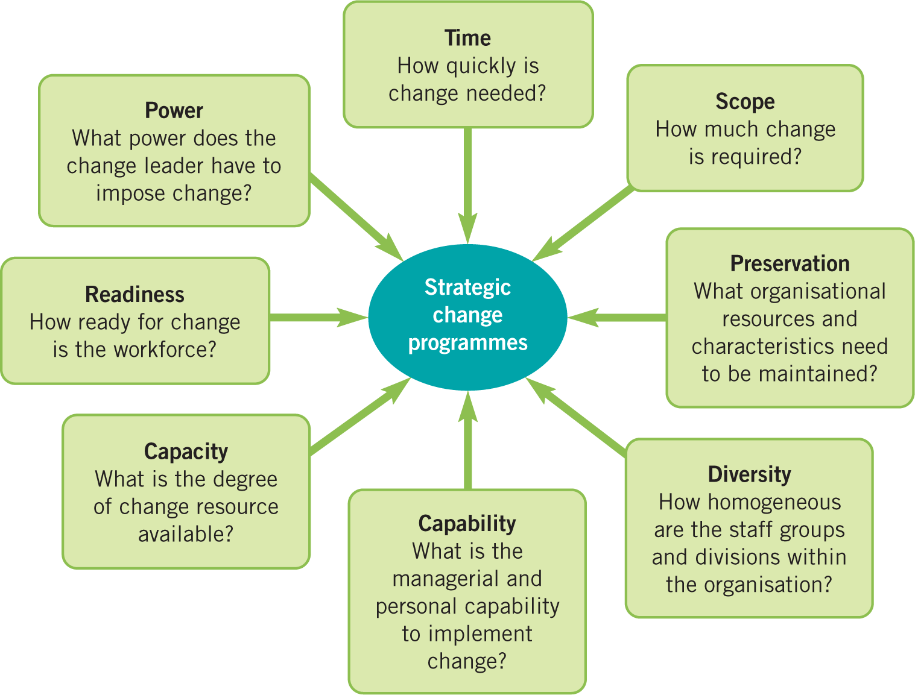
The Change Kaleidoscope
Balogun and Hailey (2016).

Slide 14
Forcefield analysis (Lewin 1951)
Forcefield analysis: provides a view of forces that act to prevent or facilitate change.
What aspects of the current situation would block change, and how can these blocks be overcome?
What aspects of the current situation might aid change in the desired direction, and how might these be reinforced?
What needs to be introduced or developed to add to the forces for change?

Slide 15
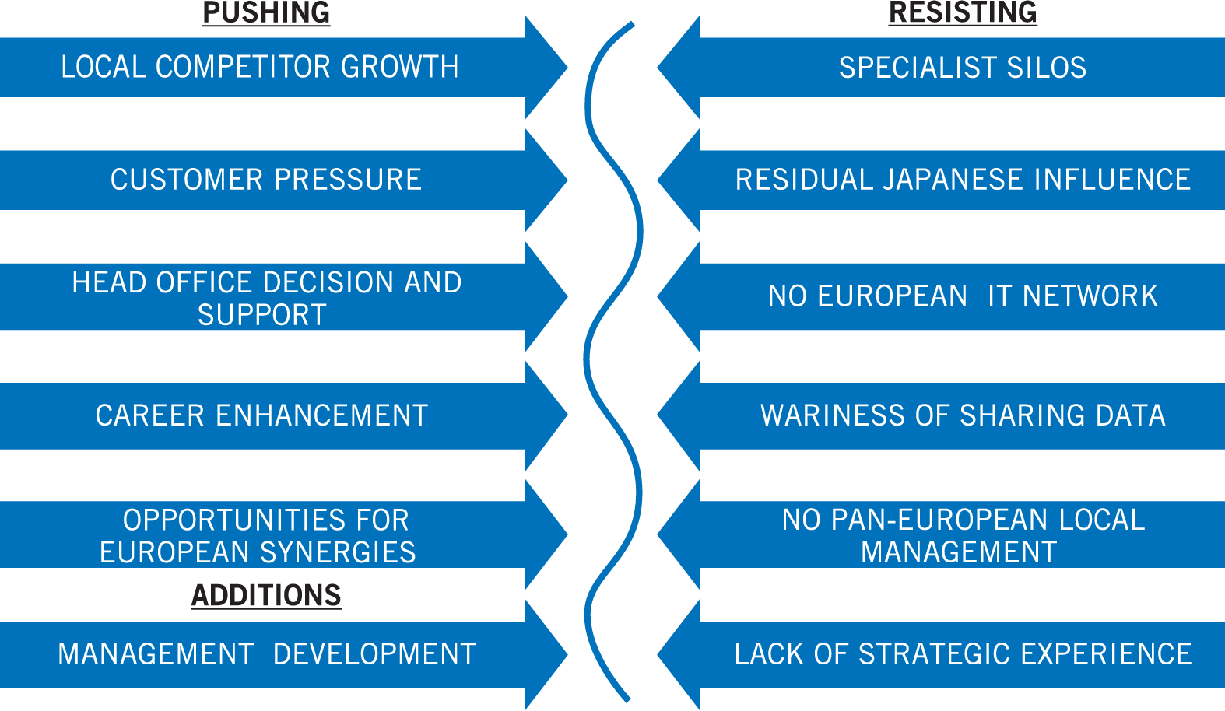
A Forcefield Analysis
Source: Lewin's (1951)

Slide 16
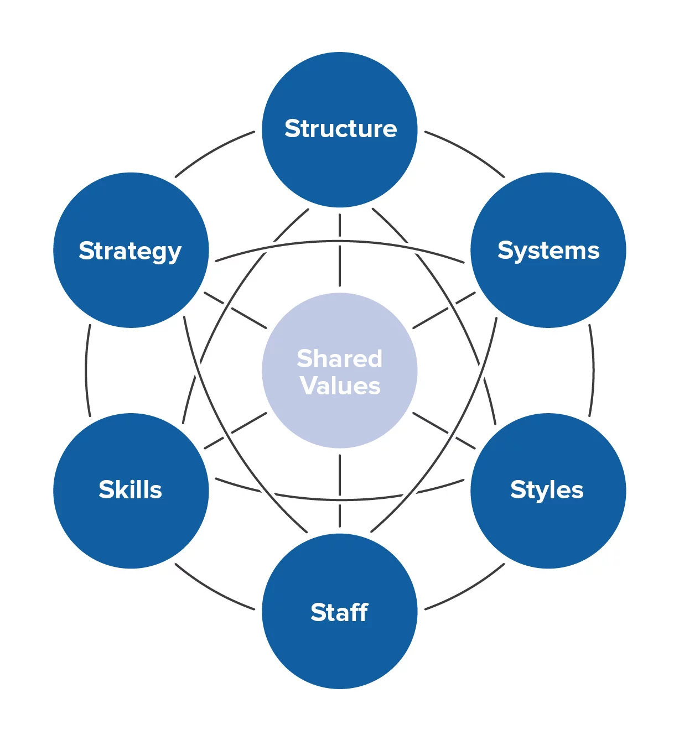
The Seven Elements of the McKinsey 7-S Framework (1980)

Slide 17
McKinsey 7-S Framework
The model was developed in the late 1970s by Tom Peters and Robert Waterman, former consultants at McKinsey & Company.
They identified seven internal elements of an organization that need to align for it to be successful.
Hard Elements are more easily defined and formalized, while Soft Elements can be more difficult to define since they deal with things like attitudes and work styles (see next slide)
The model can be used to help you to improve the performance of your organization, or to determine the best way to implement a proposed strategy.

Slide 18
McKinsey 7-S Framework
Shared Values (soft)
Skills (soft)
Staff (soft)
Strategy (hard)
Structure (hard)
Style (soft)
Systems (hard)

Slide 19
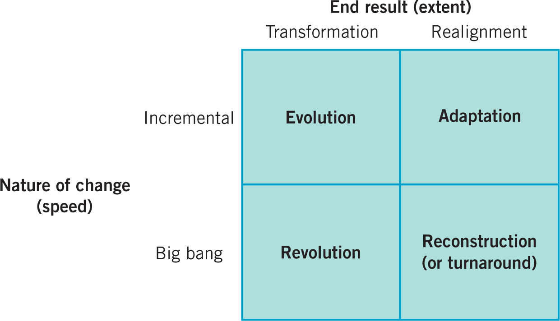
Types of change
Source: Balogun, Hailey and Gustafsson 2016, p.23.

Slide 20
Types of strategic change
Four types of strategic change:
Adaptation – can be accommodated with the existing culture and can occur incrementally.
Reconstruction (turnaround) – rapid change but without fundamentally changing the culture.
Revolution – fundamental changes in both strategy and culture.
Evolution – cultural change is required but this can be accomplished over time.

Slide 21
Levers for Strategic Change

Slide 22
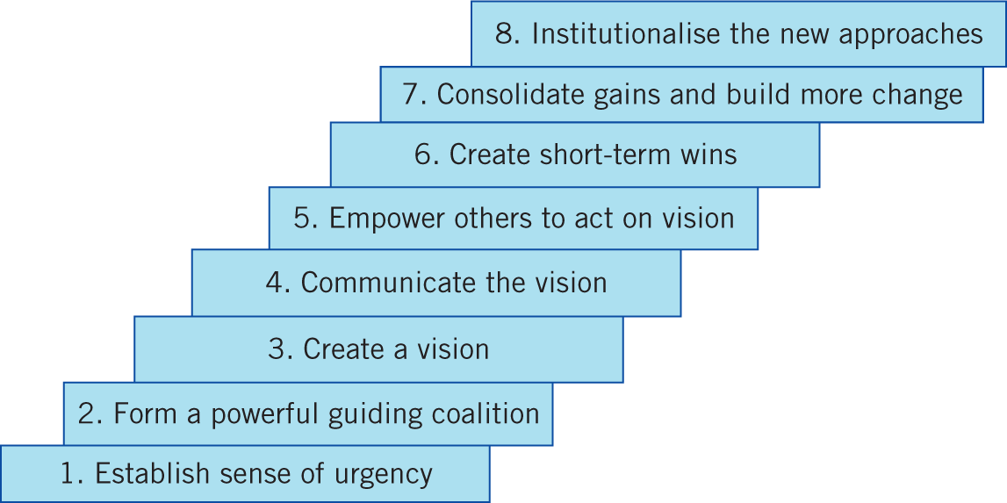
Kotter’s 8 steps for change
Source: Kotter (1996) p. 61.

Slide 23
Symbolic management
Change levers are not always of an overt, formal nature: they may also be symbolic.
Changing symbols can help reshape beliefs and expectations. Three key aspects:
Rituals – see Table in next slide.
Physical aspects – locations, dress, offices.
Behaviour of managers – the behaviour of change agents must be in line with change.
Language – can be used to galvanise the change or (unconsciously) deter it.

Slide 24
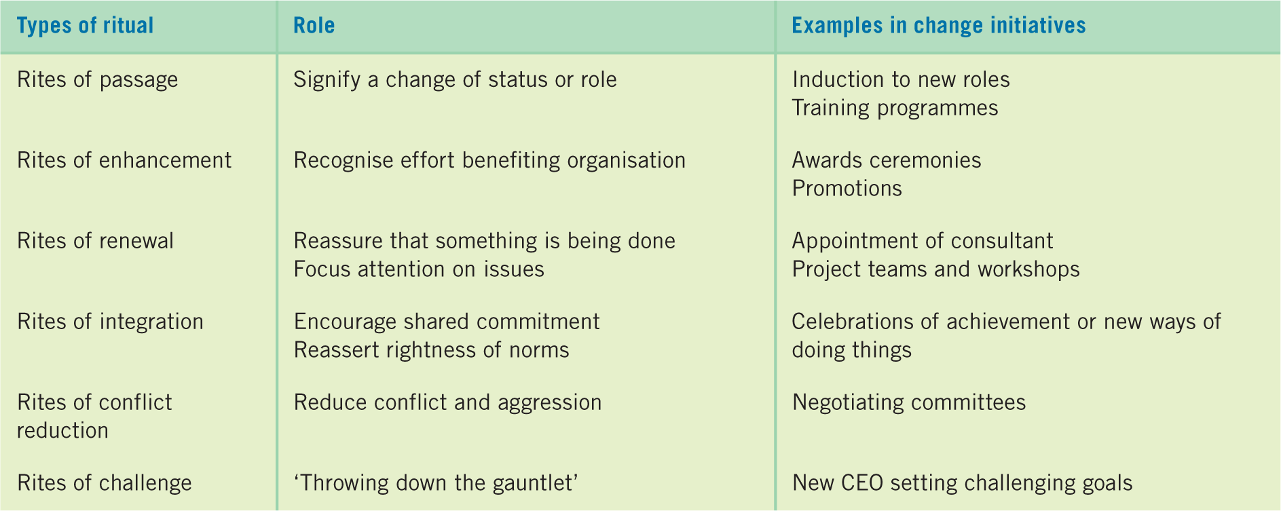
Organisational rituals and change

Slide 25
Political mechanisms in organisations
Managing change from a political perspective can be achieved using various mechanisms:
Control of resources, expertise and information.
Support and association with elites or stakeholders (powerful and/or influential people).
Building of alliances and networks.

Slide 26
Timing
The timing of change can be tactically vital.
Building on an actual or perceived crisis.
Exploiting windows of opportunity.
Symbolic signalling of time frames.
Visible short-term wins – the demonstration of such wins can galvanise commitment to the wider change strategy.

Slide 27
Problems of formal change programmes
What Formal Programmes Forget:
A lot of change happens regardless of formal programmes.
Employees continually adapt and learn in response to changing conditions.
Managers underestimate spontaneous, emergent change.
Planned change programmes can actually get in the way of the local adaptations.
Management’s job is to encourage and multiply successful local adaptations, not just impose strategic change from the top.

Slide 28

Traffic Light it
Where is your learning at?
Red = I have misunderstood some of the topics. (write down 2 questions that you need help with)
Amber = I have understood most of the topics so far (write down 1 question and 1 key theme you have understood)
Green = I have understood the topics so far (write down 2 key themes from the lesson to show your understanding)

Slide 29

Reading list
Essential Reading
Lynch, R., (2021) Strategic Management. 9th edn. London: Pearson Education
Yukl, G. (2020), Leadership in Organizations: Global Edition. 9th edn. Los Angeles: SAGE
Recommended Reading
Robbins, S.P., De Cenzo, D.A., Coulter, M. (2020) Fundamentals of Management: Management Myths Debunked! Global Edition. 11th edn. Harlow: Pearson
Johnson, G., Whittington R., Scholes K. (2020) Exploring Strategy: Texts and Cases. 12th edn. Harlow: Pearson.

